Slide 1
Ansible Tower

Slide 2
What is Ansible Tower?
Ansible Tower is web-based Graphical User Interface(GUI) that lowers the entry barrier of using ansible.
Ansible Tower is an enterprise framework for controlling, securing and managing your Ansible automation.

Slide 3
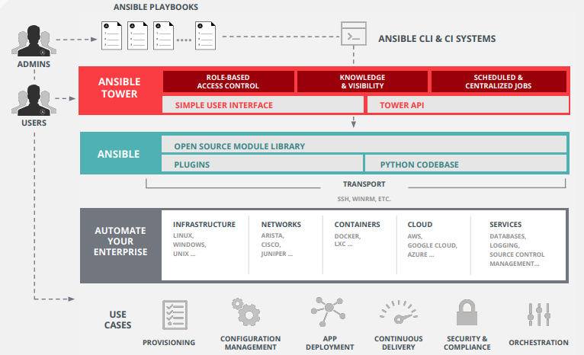
Ansible Tower Architecture

Slide 4
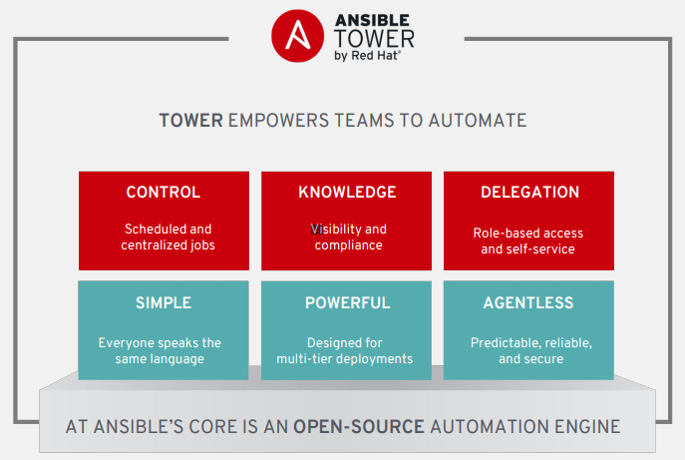
Ansible Tower

Slide 5
Ansible Tower Overview

Slide 6
Why Ansible Tower?(1-3)
Control
Visual Dashboard
Pull playbooks from SCM
Schedule jobs at any time
Easily connect to inventory sources
Model complex processes with new Workflows

Slide 7
Why Ansible Tower?(2-3)
Knowledge
Ensure environment consistency
Log all automation securely
Audit all Tower activity
Notifications inform users
Use new Enterprise Logging for analysis

Slide 8
Why Ansible Tower?(3-3)
Scale
Empower Teams to Automate
Users from LDAP/SAML and more
Role-based access control
Simple self-service surveys
Full REST API for all features
Expand capacity with new
Tower clusters

Slide 9
Possible Architectures
Single machine with integrated database
Single machine with remote database
High-availability multi-machine cluster

Slide 10
Installation of Ansible Tower
Supported Operating Systems:
Red Hat Enterprise Linux® 7.4 or later on 64-bit architecture
64-bit versions of CentOS 7.4 or later, Ubuntu 14.04 LTS, Ubuntu 16.04 LTS
Hardware Requirement:
Minimum 2 cpu
Minimum 4GB RAM on Ansible Tower host
Recommended: 4GB of memory for each 100 forks (Managed by forks configuration parameter in job template or system configuration)
150 GB VM storage, 10 GB for /var, additional 20 GB for database

Slide 11
Installation of Ansible Tower
Installation pre-req:
Installation performed by executing Ansible Playbook. Current installation program automatically installs Ansible Engine and any dependencies not already present. Latest stable version of Ansible Engine must be installed on installation server using distribution’s package manager
Red Hat Enterprise Linux 7 users must enable extras repository
SELinux policy set to enforcing, permissive, disabled

Slide 12
Installation of Ansible Tower
There are 2 installers:
Standard installer
Always contains latest version of Ansible Tower for Red Hat Enterprise Linux 7
Archive is smaller, but requires Internet connectivity to download Ansible Tower packages from repositories
Available for all supported OS
Bundled installer for Red Hat Enterprise Linux 7
Archive includes initial set of RPM packages so that Ansible Tower can be installed on systems disconnected from Internet
May be preferred in high-security environments
Systems still need access to software packages for Red Hat Enterprise Linux 7 and Red Hat Enterprise Linux 7 Extras channel
Not available for Ubuntu

Slide 13
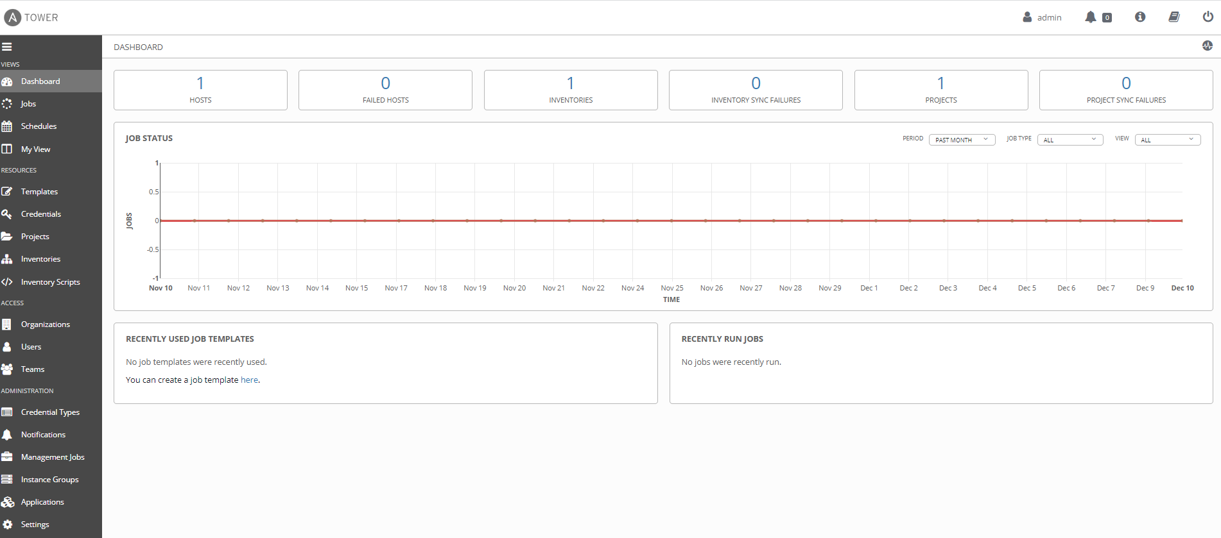
Dashboard page

